Slide 1
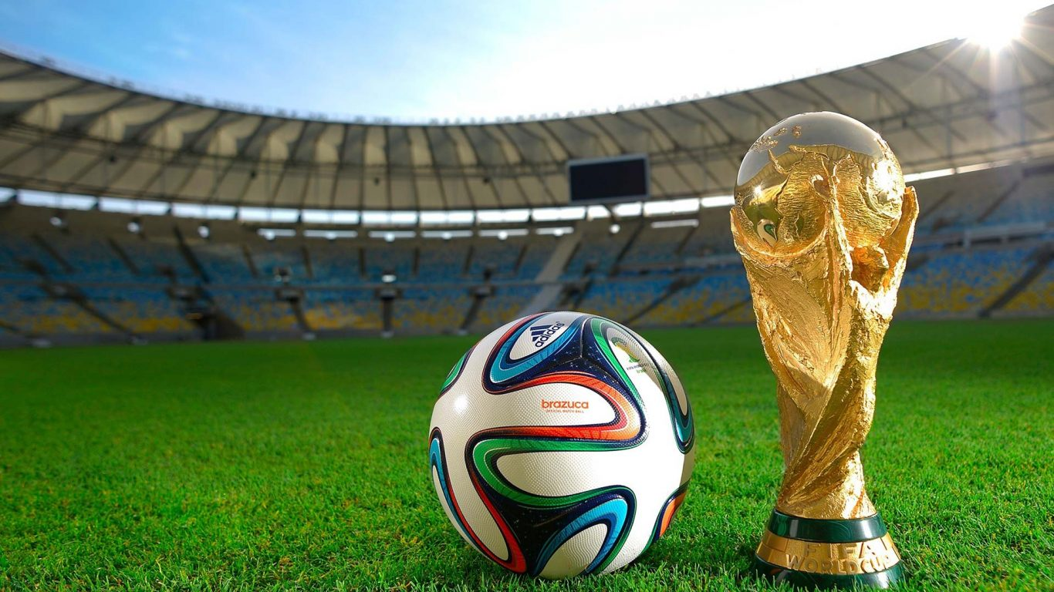
Minor Project REPORT
FIFA DATA ANALYSIS

Slide 2

RITAM PRADHAN
DATA SCIENCE INTERN - SKILLVERTEX

Slide 3

INTRODUCTION
FIFA is a non-profit organization that describes itself as an international governing body of association football, futsal, and beach soccer. It is the highest governing body of association football.

Slide 4

ABSTRACT
FIFA Datasheet provide details about the players all over the world. This datasheet provide insights to every minor details about the players. These minor details such as most preferred foot, international Reputation, Week Foot, Skill Moves, weights, value, wage, potential scores, overall scores helps us in determining the overall performance of the players.
Also, these details can be analyzed to compare them on the basis of countries which actually helps determining which countries are eligible for a grand tournament.

Slide 5

TOPICS COVERED
Importing Libraries
Reading Data into Data Frame
Dropping Unnecessary Features
Handling Missing Data
Univariate Analysis
Bivariate Analysis
Plotting of Graphs
Functions from sklearn
Data Science

Slide 6

CONCLUSION
This data analysis of the players of FIFA all over the world has helped me getting a deep understanding of the comparison among their skills and potential. It also gave me an idea of which countries are more suitable for participating in the world tournaments and also gave the idea about the potential of the countries which are yet to be eligible for world tournaments.
Also, the demand for the best players across the globe is also available thanks to the data analysis.

Slide 7

Thank you
Ritam.pradhan2002@gmail.com
https://www.linkedin.com/in/ritam-pradhan-73283020a/

